Slide 1
Introduction to the Arduino
Pierce Nichols
14 April 2015
Presentation © Logos Electromechanical LLC 2015
CC BY-NC-SA-3.0

Slide 2
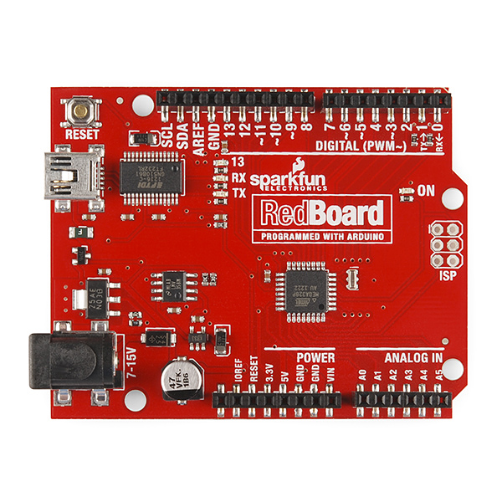
Topics for Today
What is the Arduino?
Setting up your Arduino
Arduino IDE
Hello World!
Digital Output (blinking an LED)
Digital Input (responding to a button press)
Analog Input (sensing a potentiometer)
Expansion Boards (shields)
Image courtesy Sparkfun Electronics
CC BY-NC-SA-3.0

Slide 3
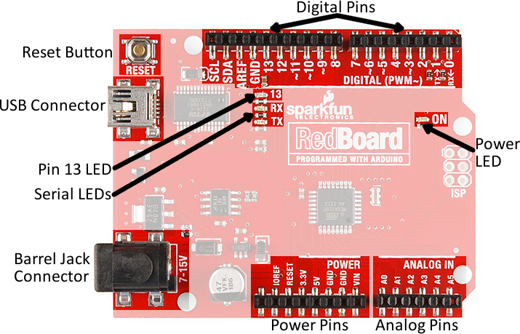
Parts of the RedBoard
Image courtesy Sparkfun Electronics
CC BY-NC-SA-3.0

Slide 4
Microcontroller: The brain of your Arduino
Miniature computer
Processor
Long-term storage (Flash)
Short-term storage (RAM)
Digital (binary) inputs and outputs
Analog inputs
Pulse-width modulated outputs (pseudo analog output)
Atmel ATMega328p
16 MHz clock
32 kB Flash memory for program storage
2 kB RAM memory
1 kB EEPROM
14 digital input/output pins
6 analog input pins

Slide 5
Installing the IDE
Download Arduino 1.6.0 installer from http://arduino.cc/en/Main/Software
Follow driver installation instructions for Arduino Duemilanove if it doesn’t install automatically
Launch the IDE
Plug in your RedBoard

Slide 6
Driver Installation
On many Windows and Linux installations, drivers are pre-installed and it just works. The Redboard will show up as a COM port (Windows) or a ttyUSB device (Linux and Mac)
On Macs and some Windows and Linux installations, you will need to install drivers.
Download the VCP (Virtual COM Port) drivers for your system from http://www.ftdichip.com/Drivers/VCP.htm
Follow the instruction on that page for your system

Slide 7
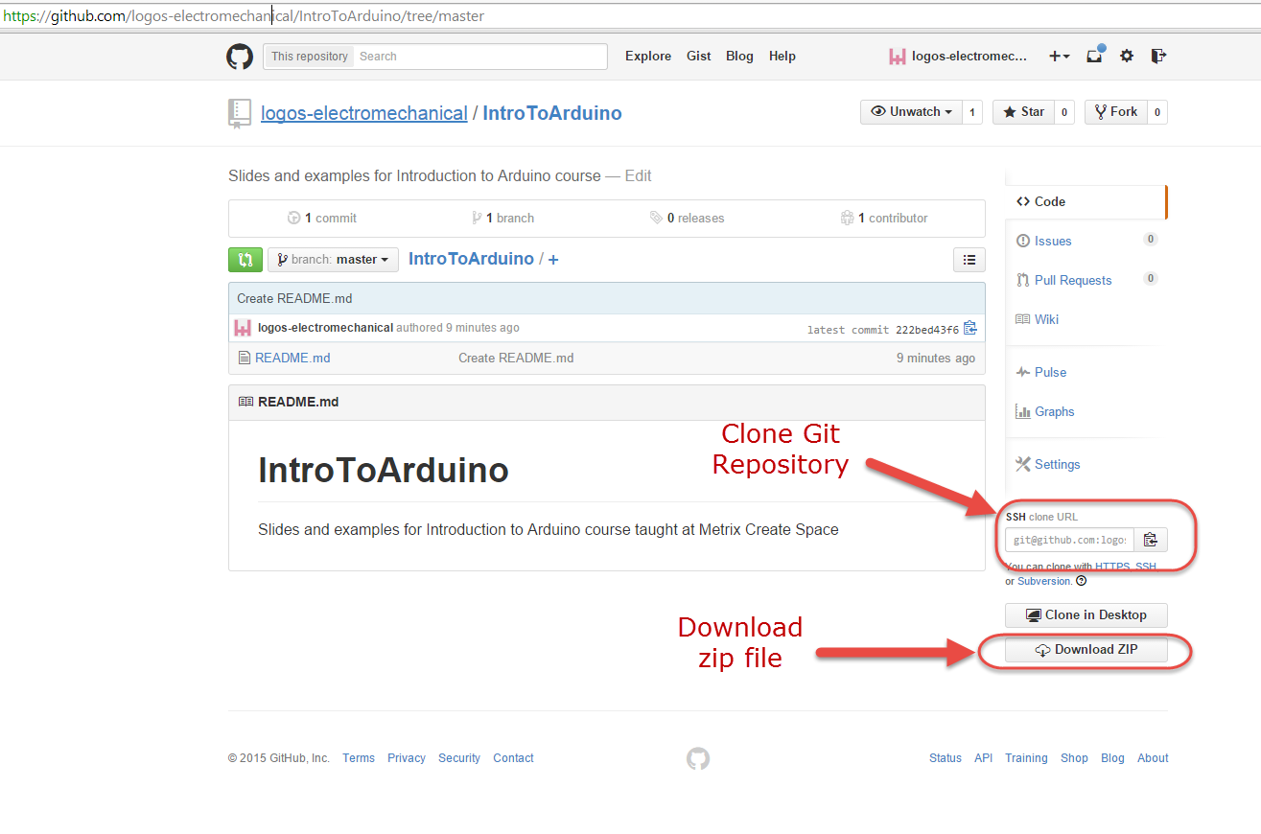
Download the Slides & Examples
Go to the Github repository, https://github.com/logos-electromechanical/IntroToArduino/tree/master
If you have git set up on your machine, clone the repository.
Otherwise, download a zip file of the repository.

Slide 8
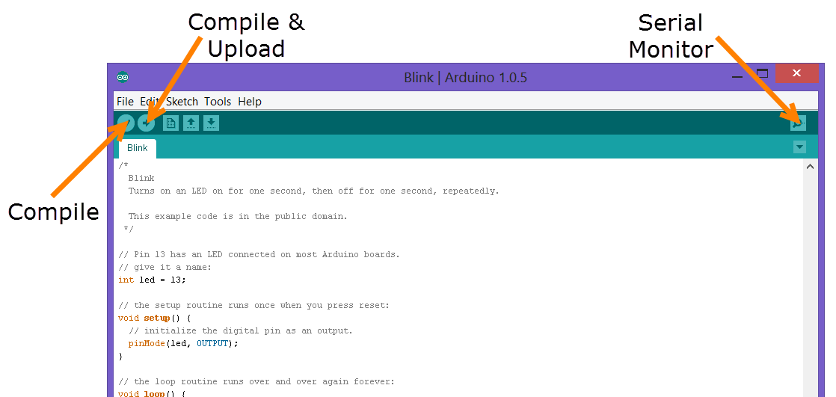
Arduino IDE buttons

Slide 9
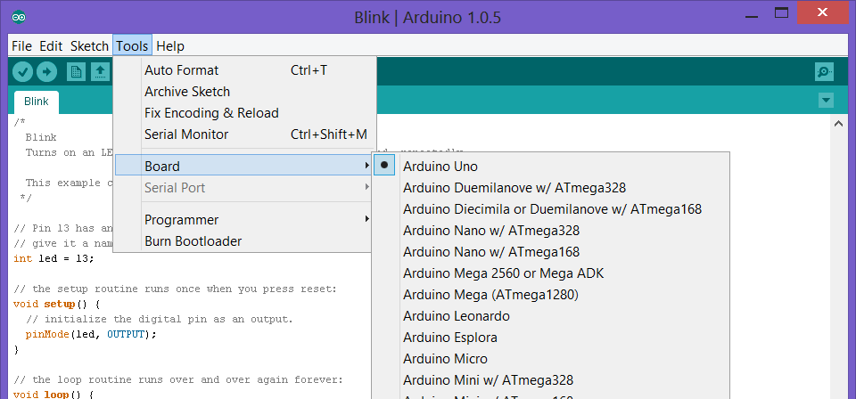
Selecting you Board

Slide 10
Hello World!
setup() function runs once at the beginning of program execution
loop() function is called repeatedly during program execution
Serial.begin() sets up the serial port and sets the speed.
Serial.println() prints a line to the serial port
delay() waits for the given number of milliseconds
See http://arduino.cc/en/Reference/HomePage for documentation of Arduino language constructs.

Slide 11
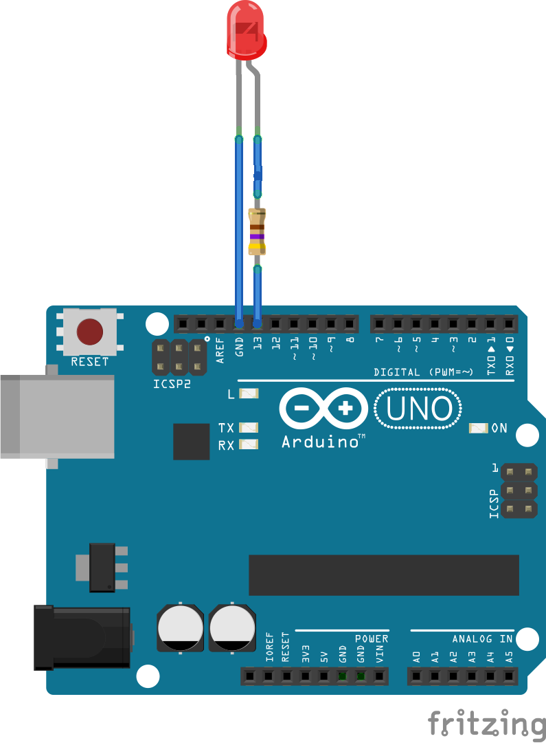
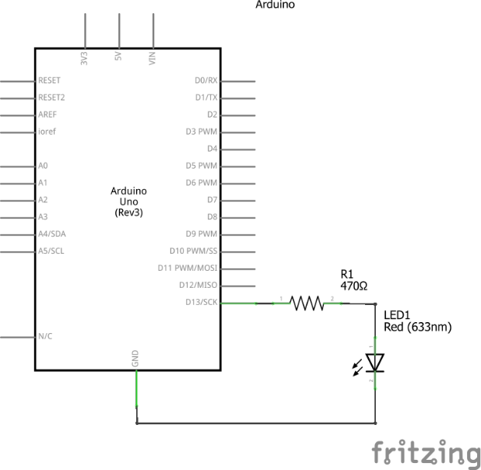
Wiring for Blink

Slide 12
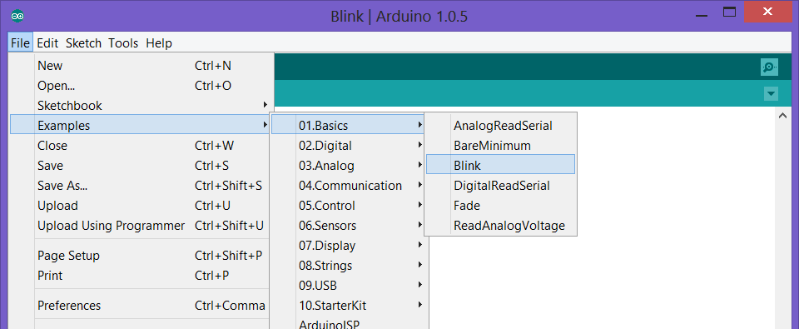
Opening Blink Sketch…

Slide 13
Blink Sketch Explanation
pinMode() sets the selected digital pin to either OUTPUT or INPUT. Pins default to INPUT.
digitalWrite() sets the selected pin either LOW or HIGH. Pins default to LOW.
delay() waits for the given number of milliseconds
What blinks other than the LED you added?
Play with adding more LEDs, different delay lengths, more complex sequences.

Slide 14
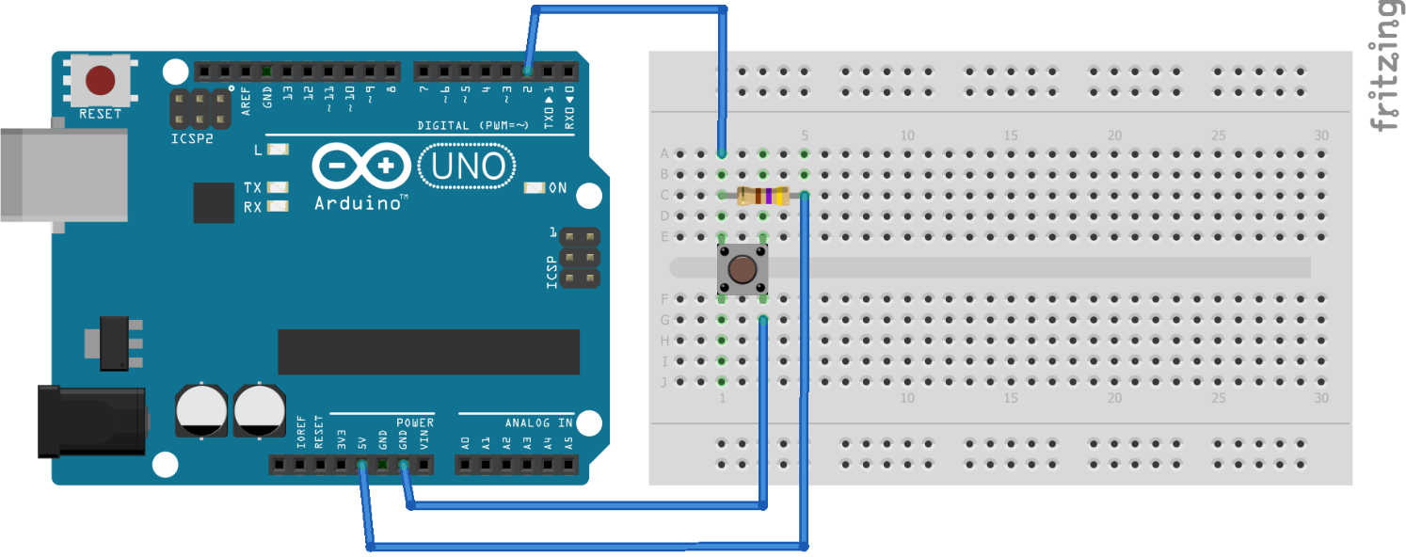
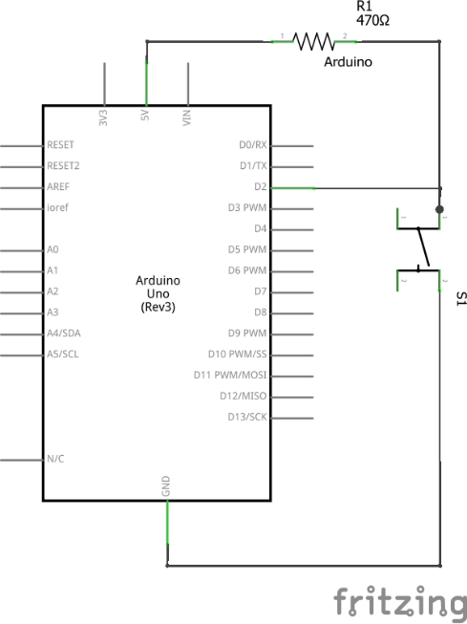
Button Wiring

Slide 15

Opening Button Sketch

Slide 16
Button code explanation
digitalRead() returns the state of the named pin, either HIGH or LOW
If() and else() are branching statements – they allow the program to do different things depending on the input.

Slide 17
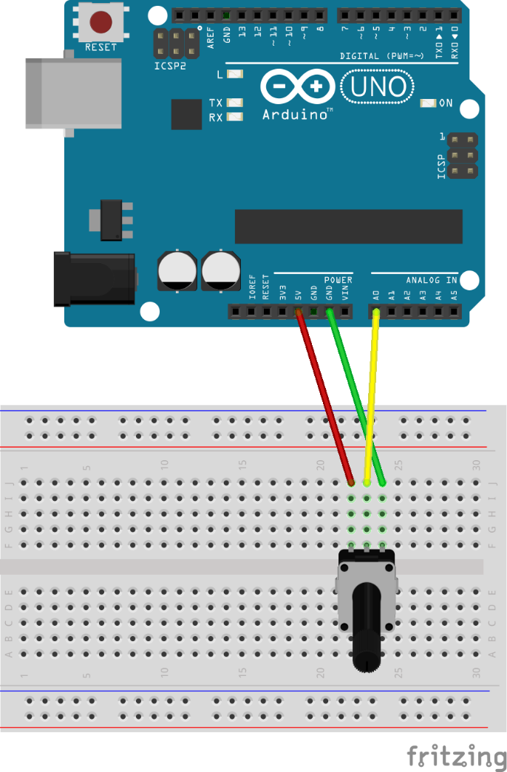
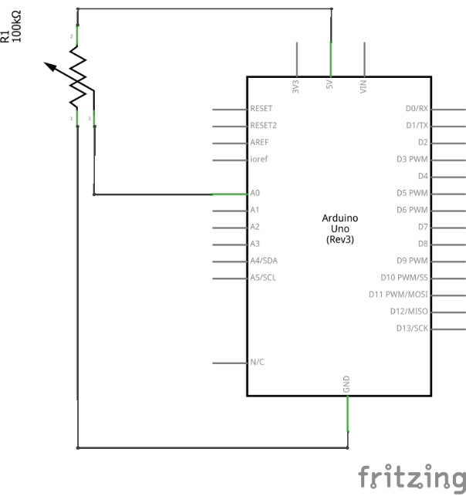
Analog Input Wiring

Slide 18
AnalogRead code
analogRead() returns the analog value from the given pin as a number between 0 and 1023

Slide 19
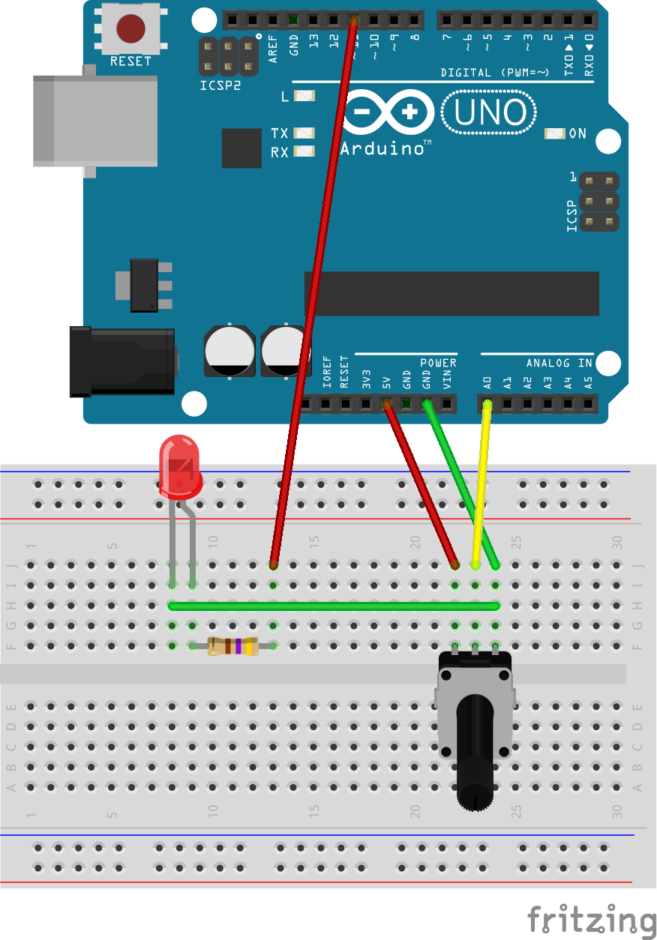
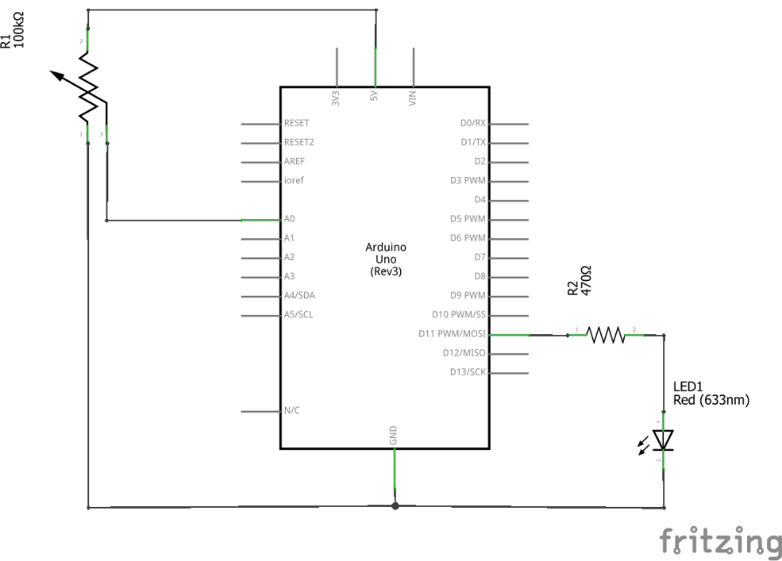
Analog LED Control Wiring

Slide 20
Analog LED Control Code
map() maps a value from one range to another. analogInput() returns a value between 0-1023 and analogOutput() takes a value from 0-255
analogWrite() simulates the given voltage by turning the target pin on and off quickly with a variable duty cycle.
Serial.print() prints a value or a string without adding a newline at the end.

Slide 21
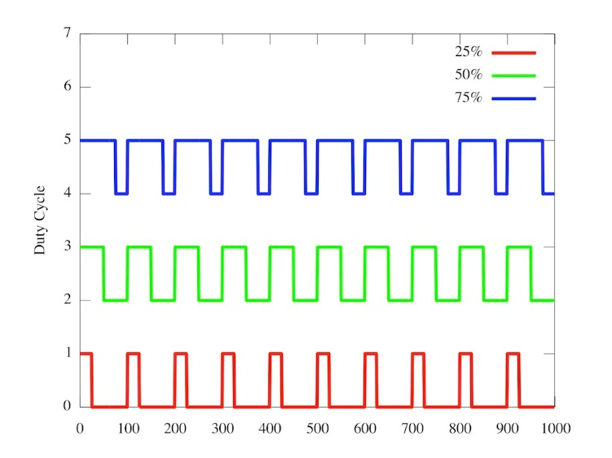
Pulse Width Modulation

Slide 22
SerialRead
Same wiring setup as the AnalogLEDControl example
Uses Serial.read() to determine what to do
Uses Serial.parseInt() to read in an integer
Uses millis() to figure out what time it is

Slide 23
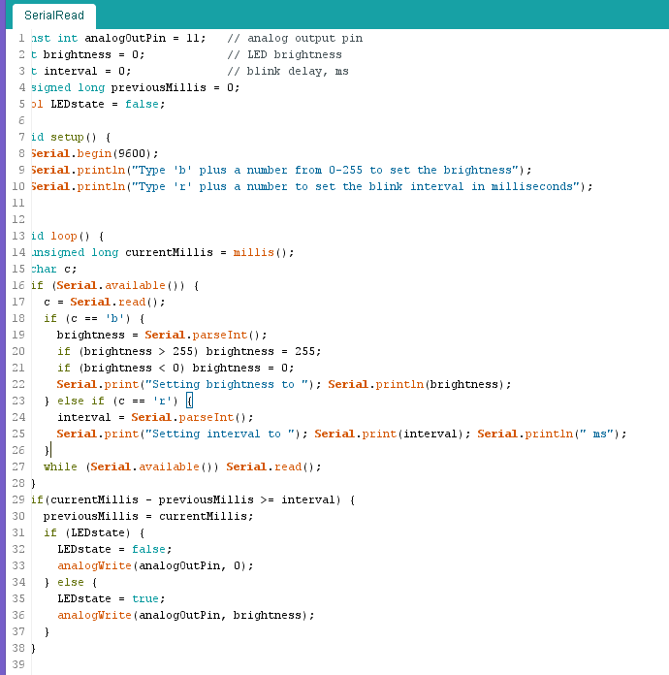

Slide 24
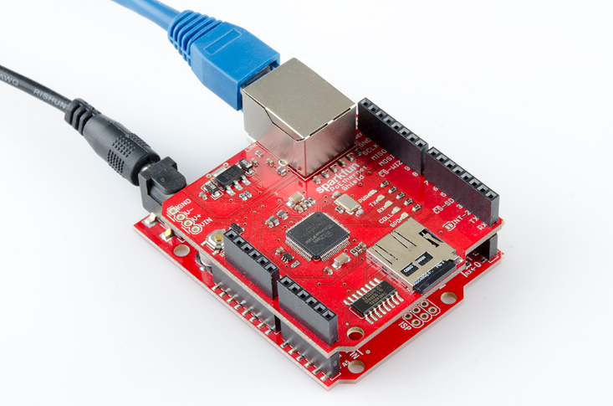
Expanding the Capabilities of the Arduino
Using external power supplies other than USB (DC jack, Vin pin)
Using shields – external expansion boards. Ethernet, LCDs, motor drivers, etc.

Slide 25
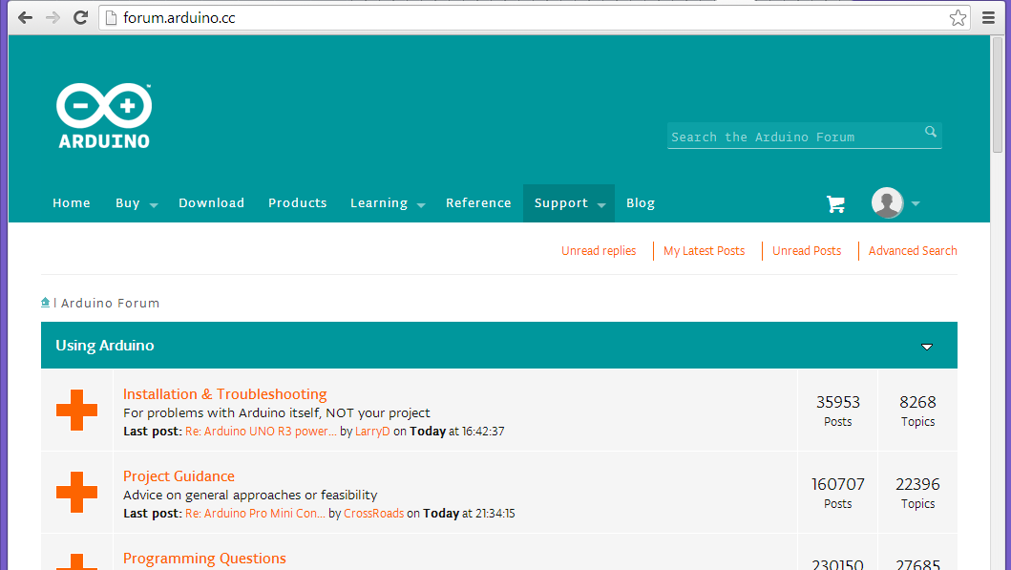
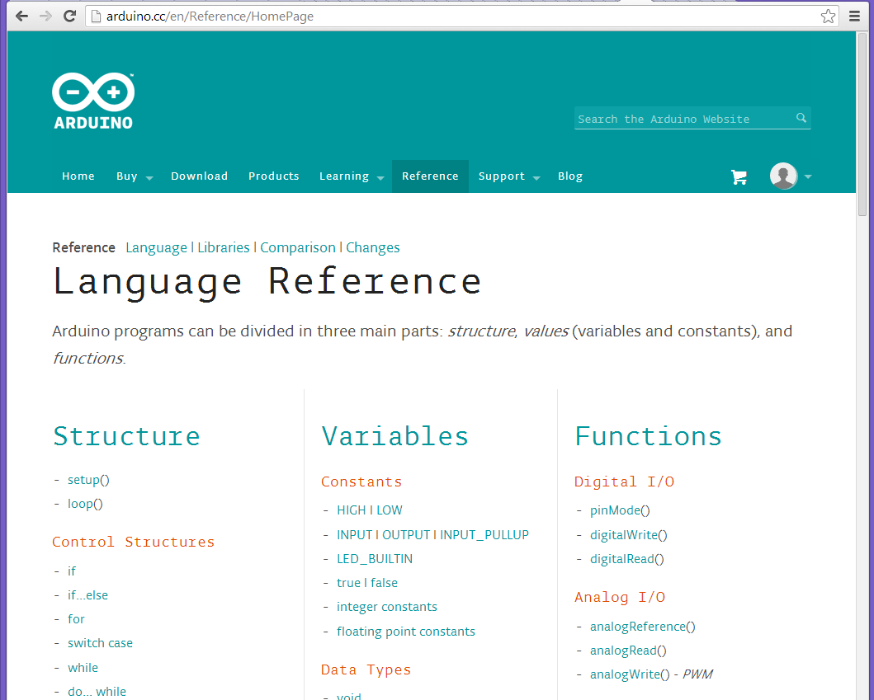
Further Resources

Slide 26
